Slide 1
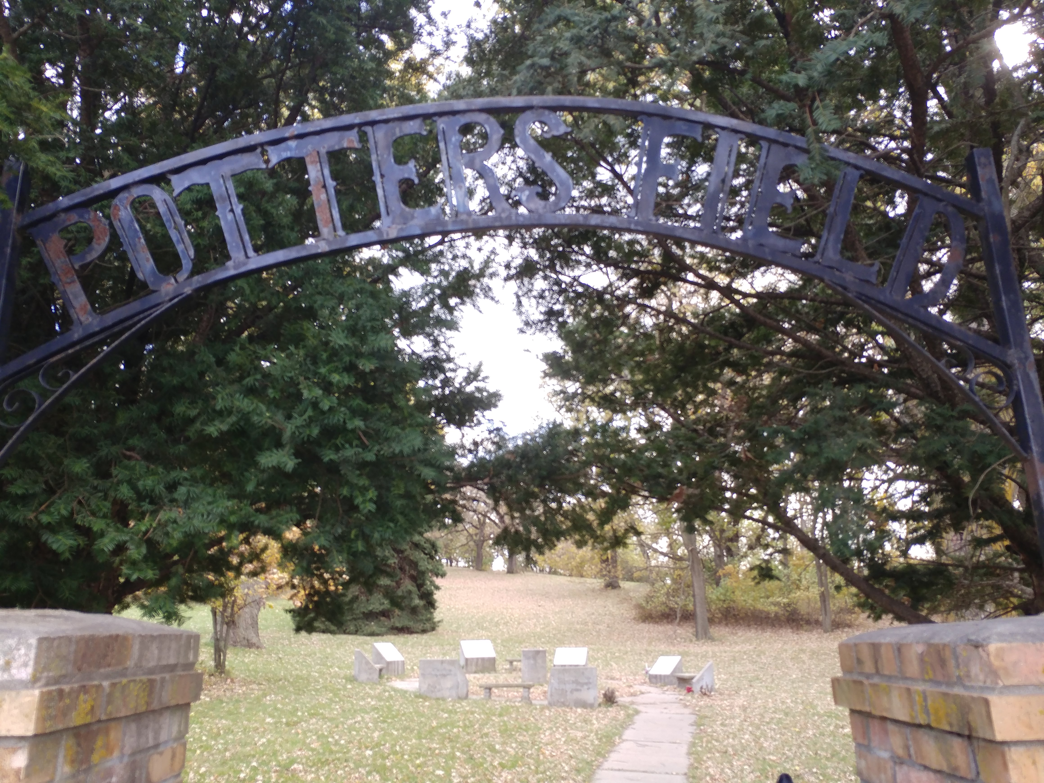
Potter's Field

Slide 2
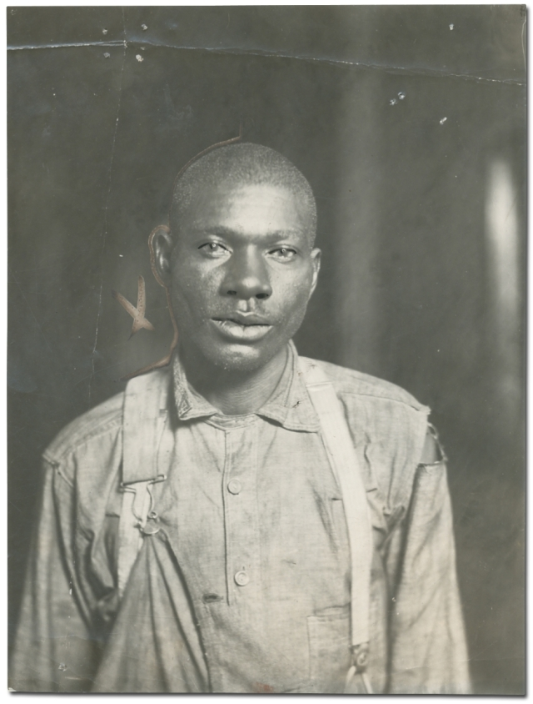
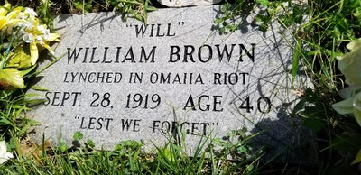
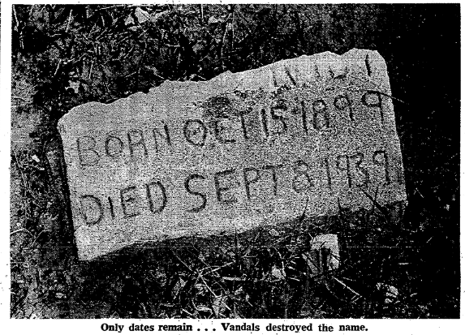
Site Significance

Slide 3
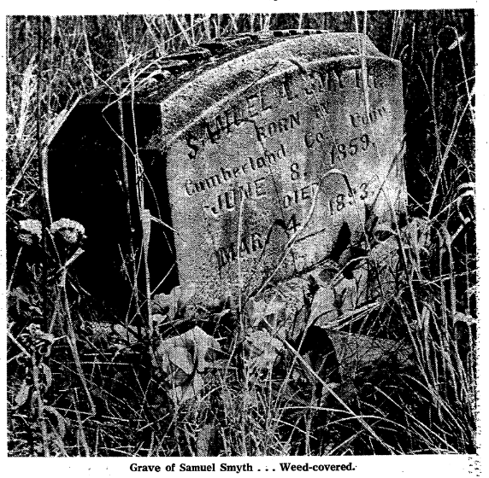
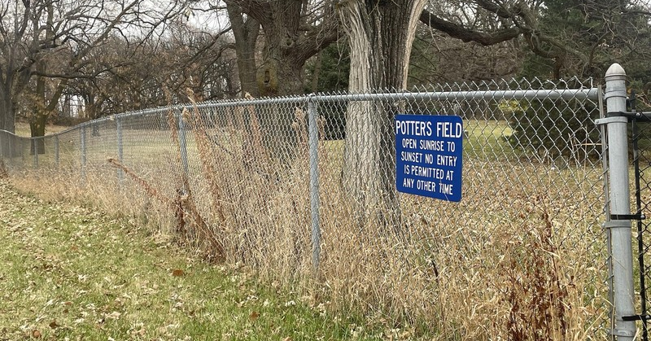
Why did I choose it?
Because of the nature of a Potter’s Field
Knowledge of Will Brown
I wanted to see how they portrayed and remembered those buried there
Little to no information about it from a simple google search

Slide 4
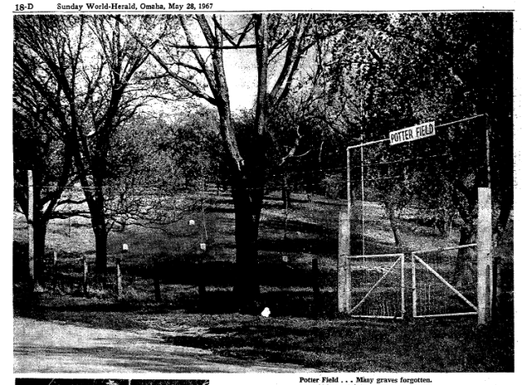
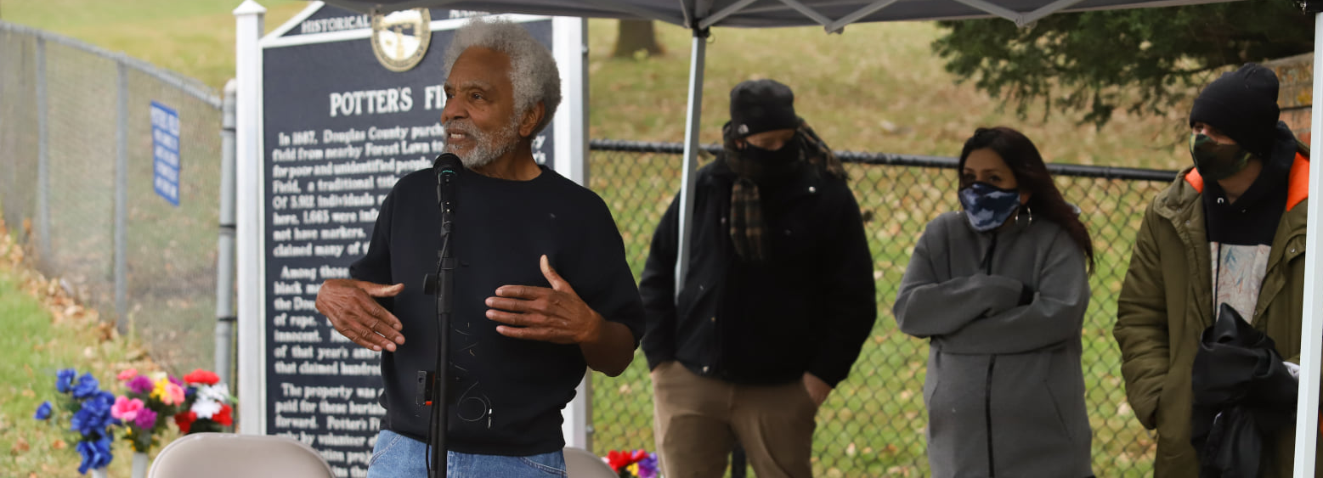
Overarching Question
What was the process to revitalize the cemetery? How did they make their decisions? How involved or supportive was the community?

Slide 5
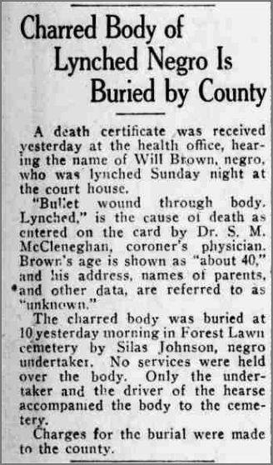
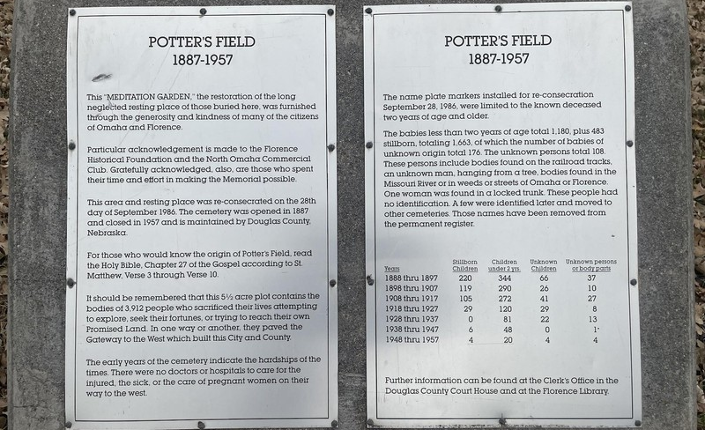
Secondary Sources
Historical Marker, meditation garden plaques
OWH articles of restoration project and original Riot Articles
Facebook group for historical marker establishment

Slide 6
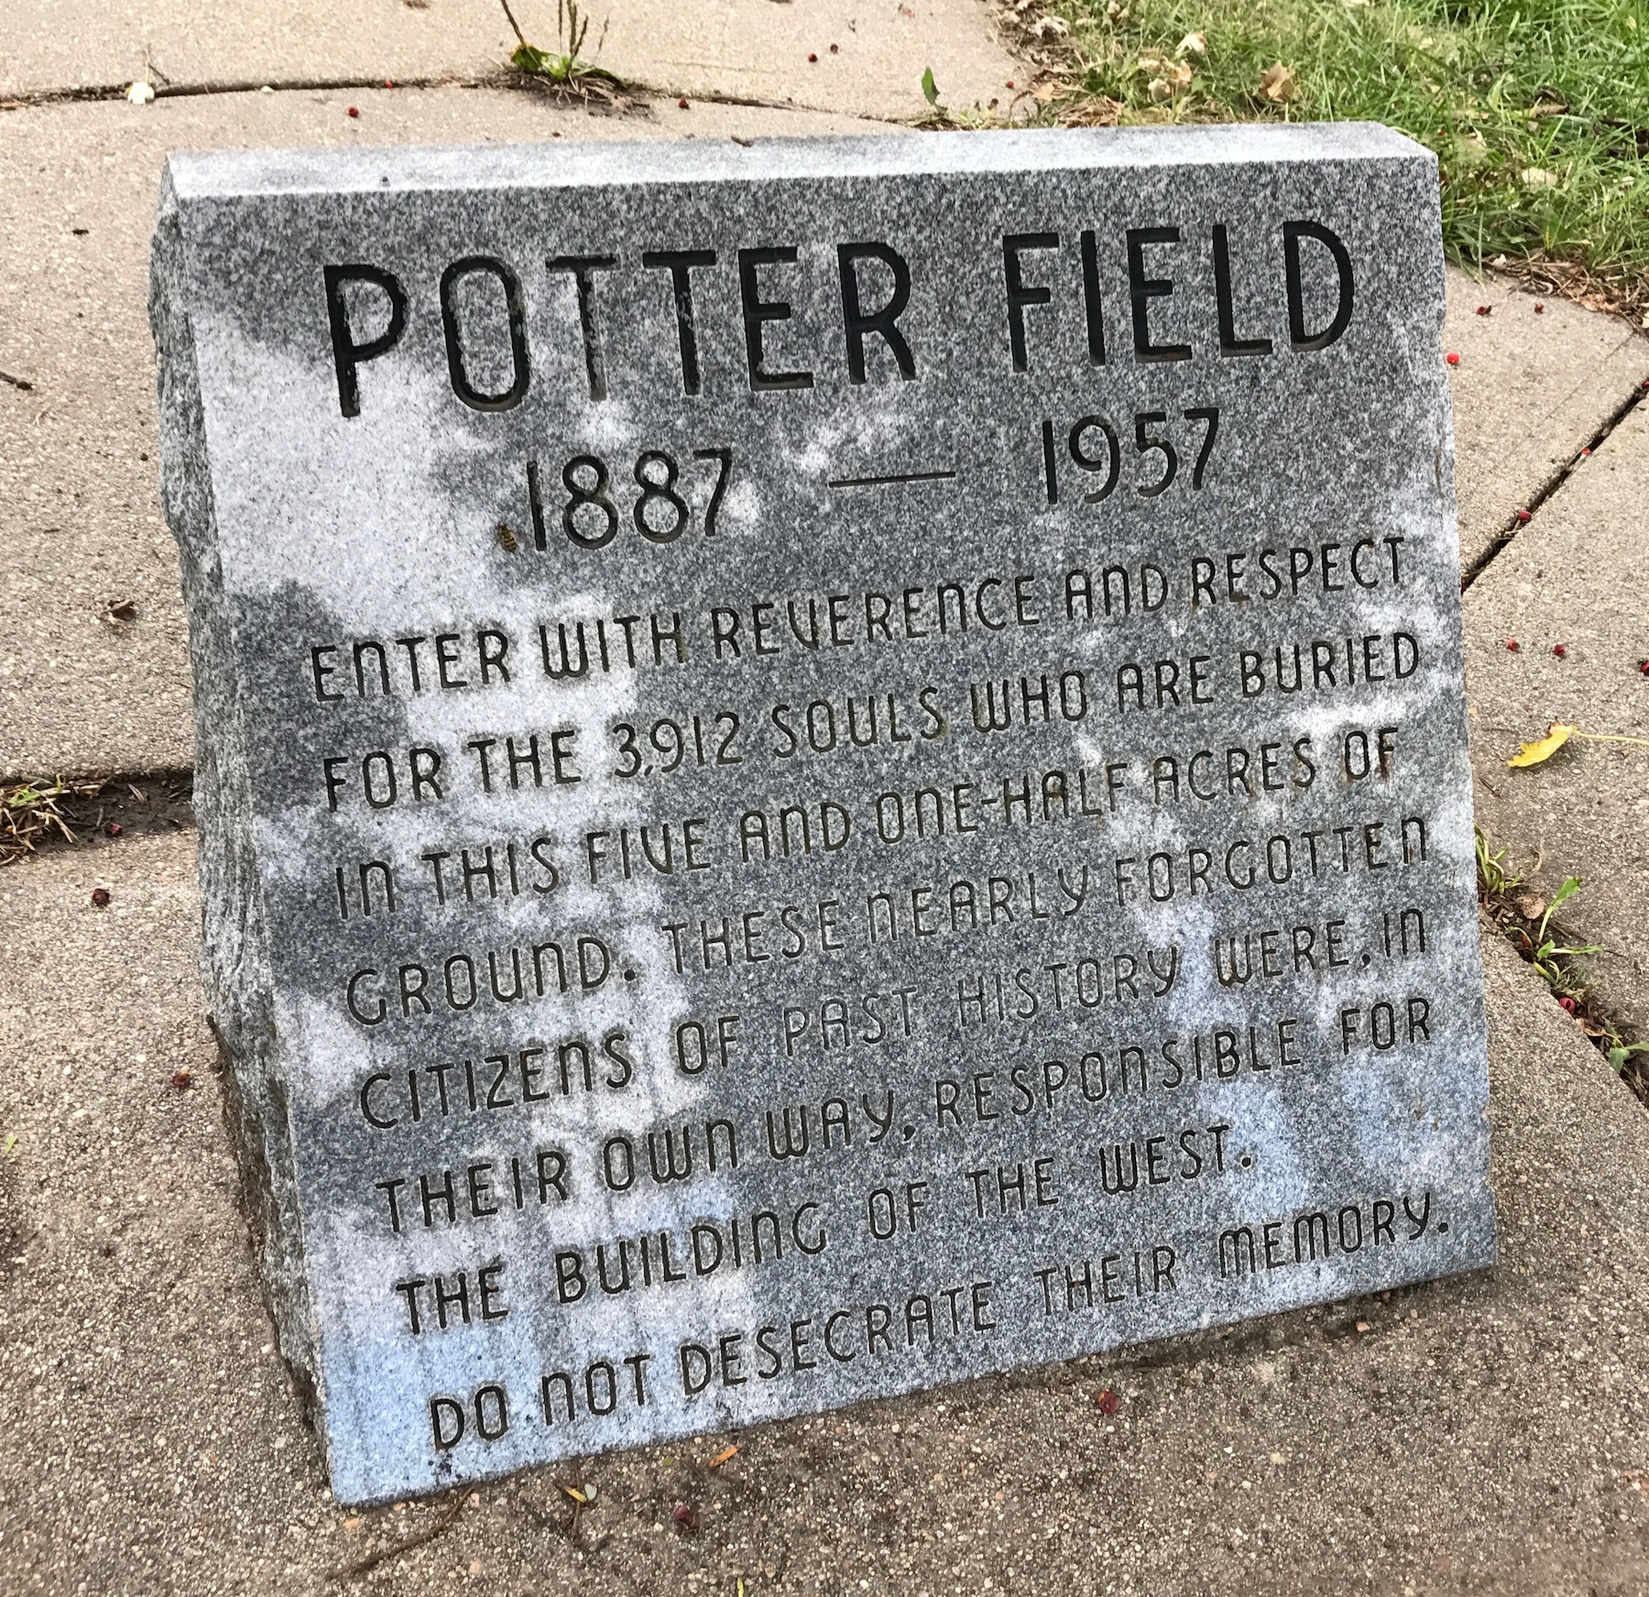
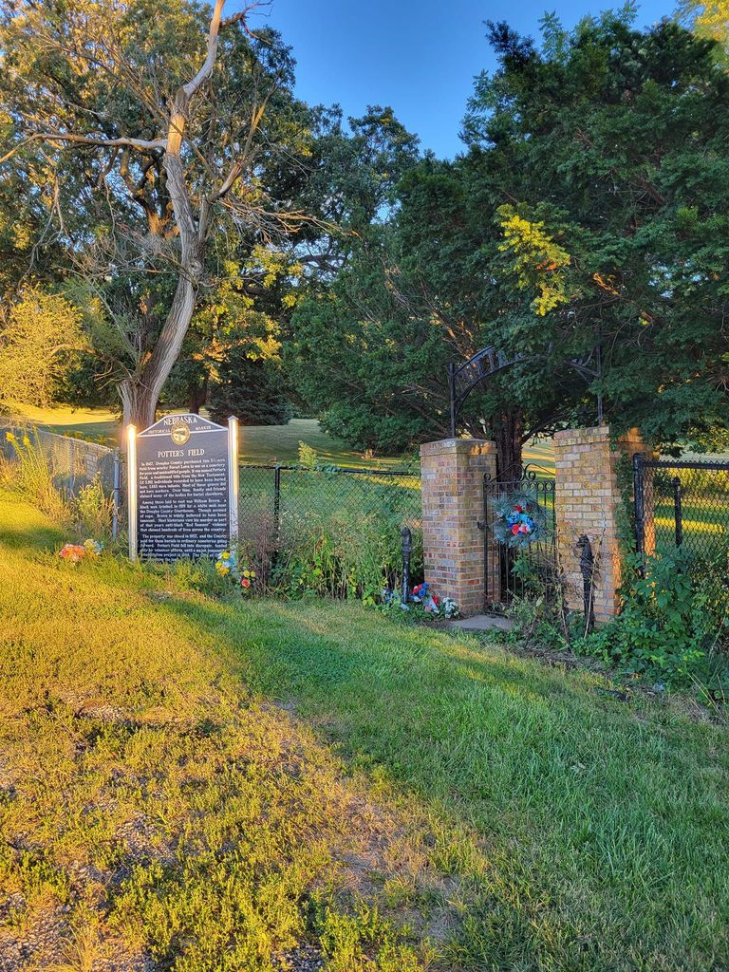
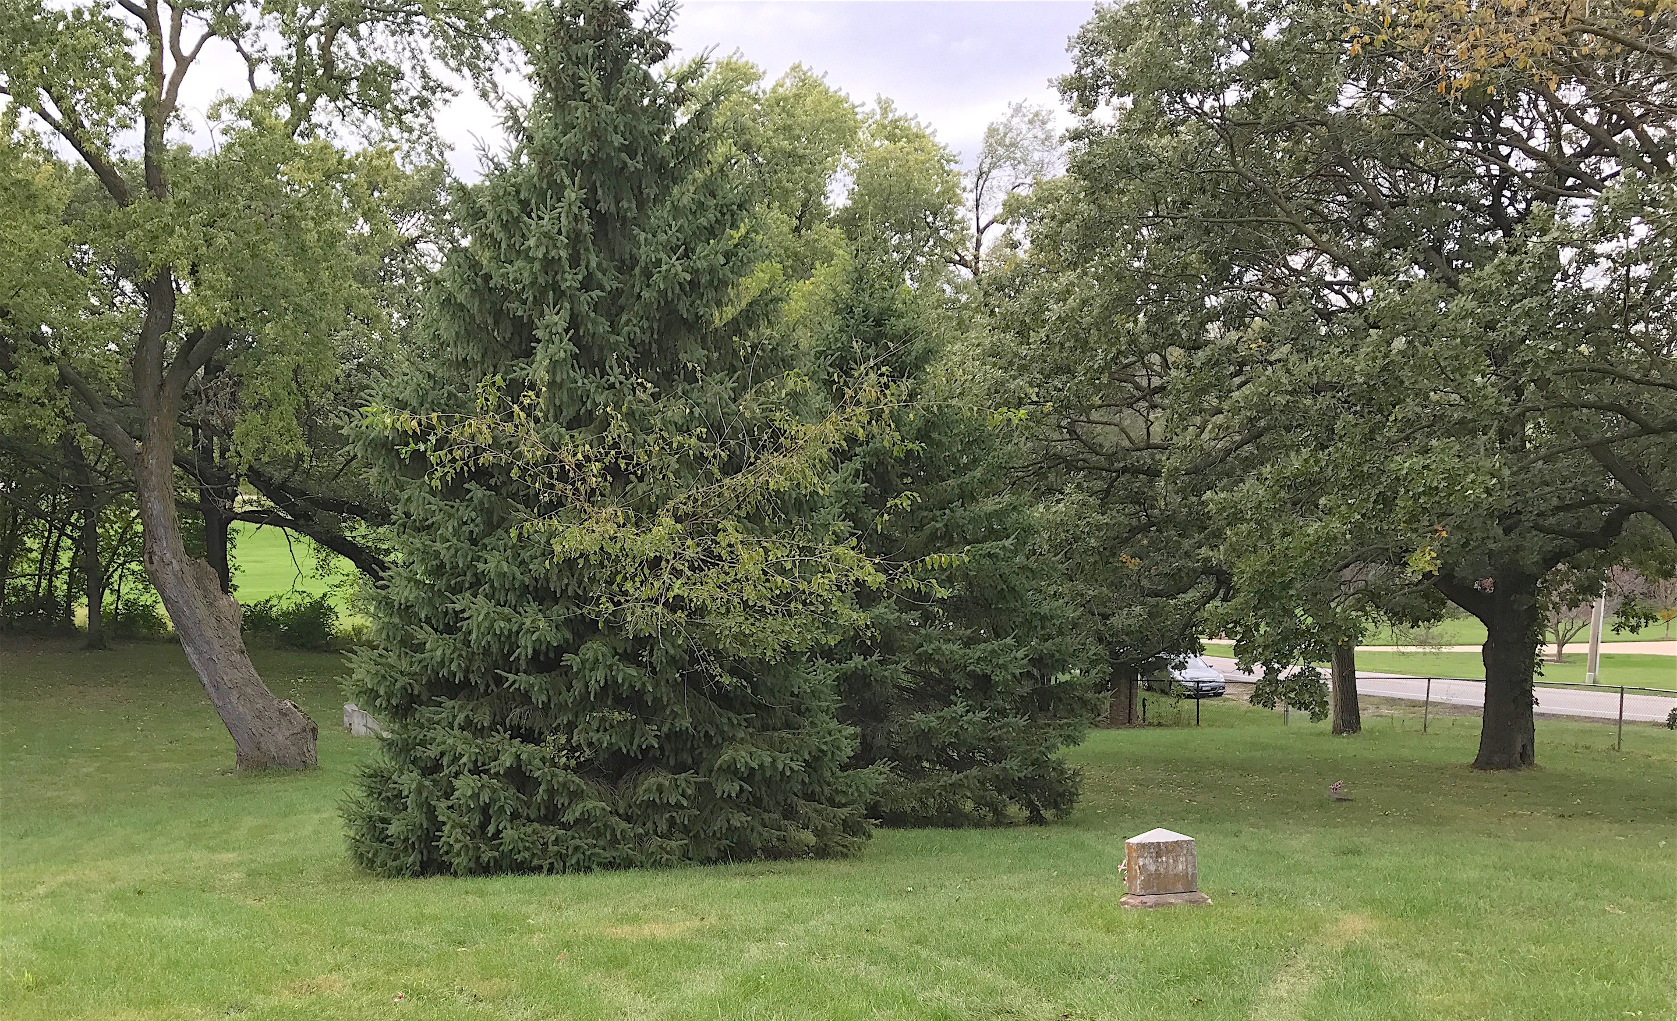
Use of Space

Slide 7
Use of space

Slide 8
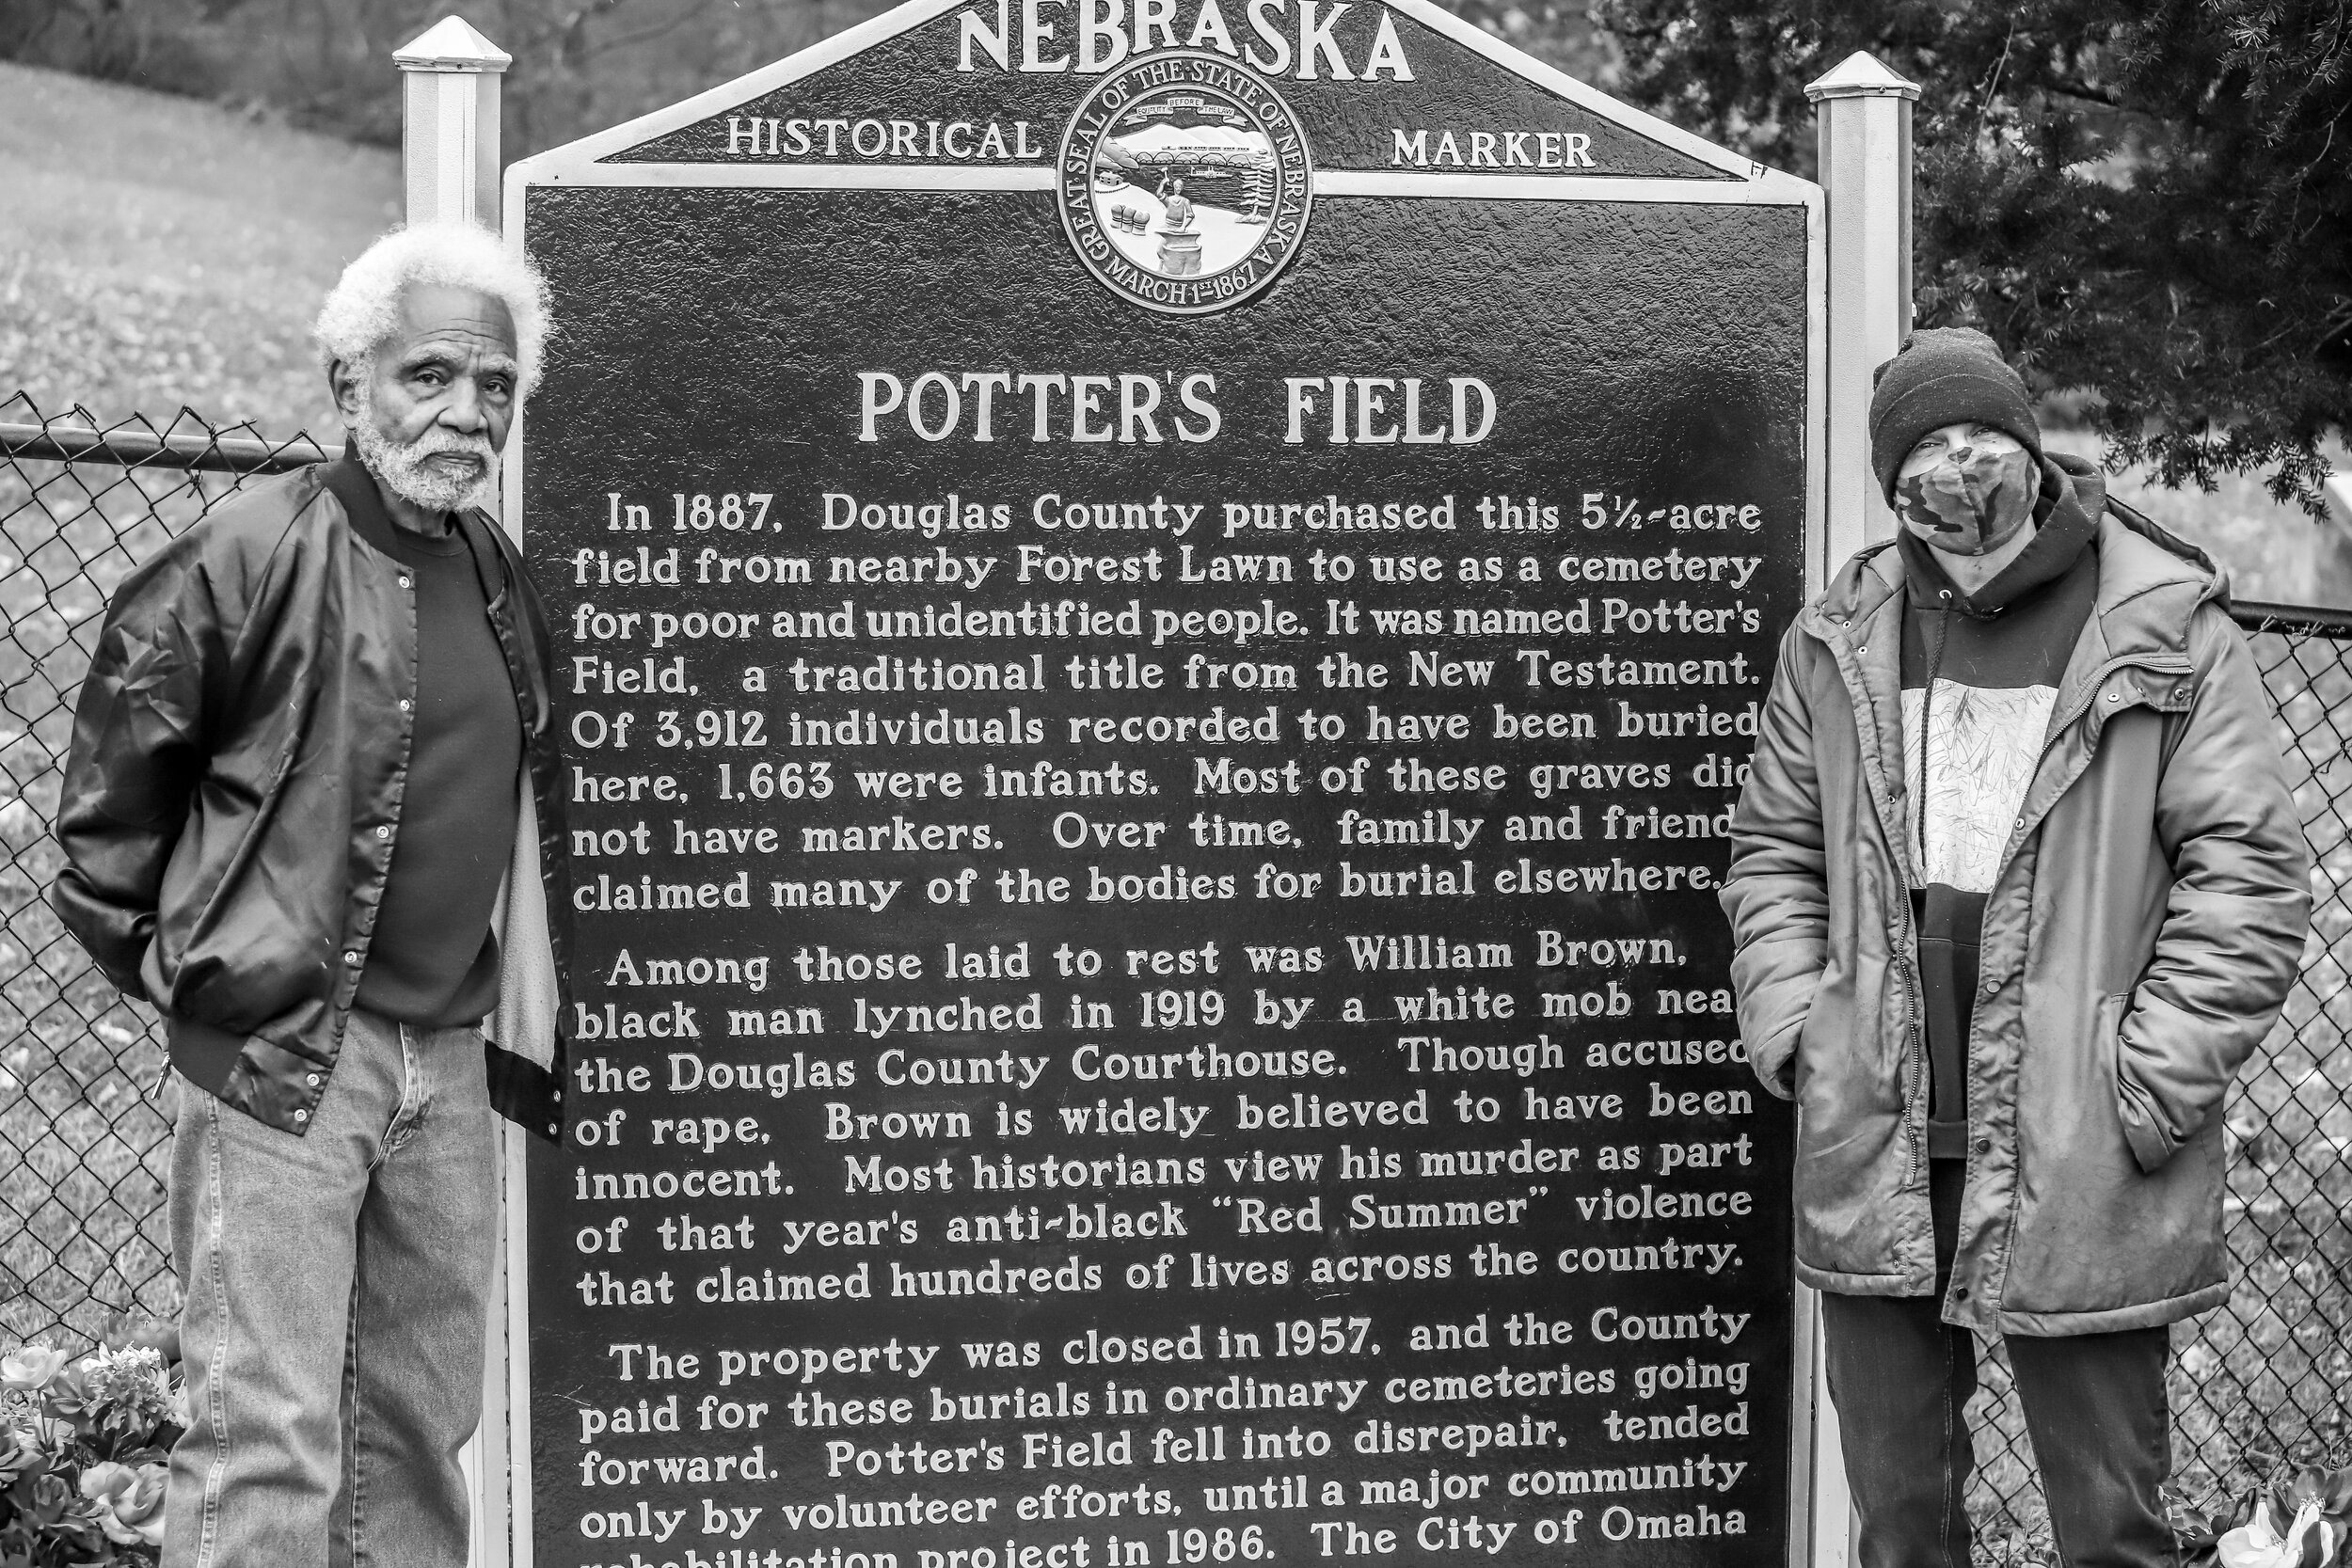
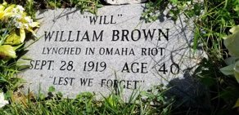
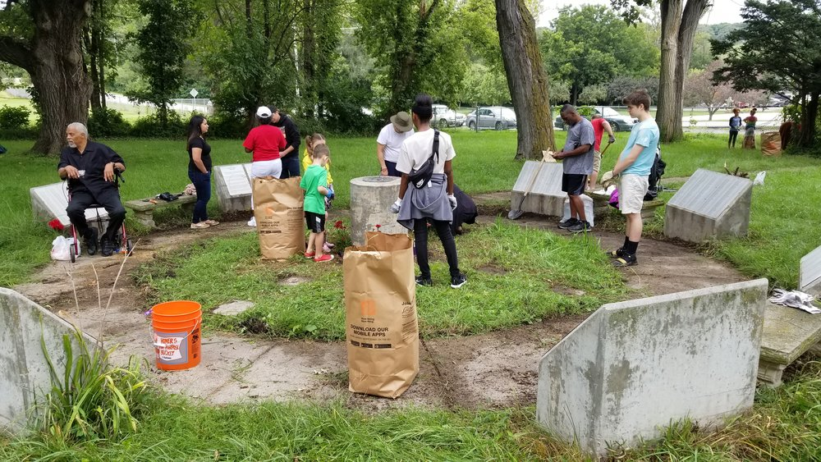
Community Projects and Historic Conservation

Slide 9
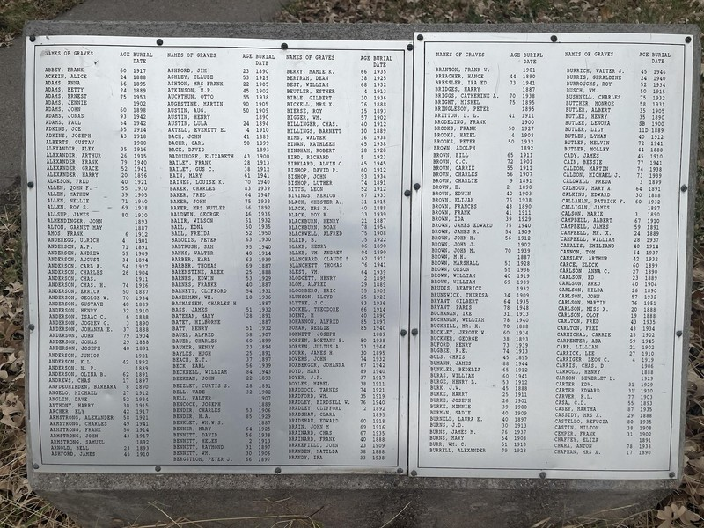
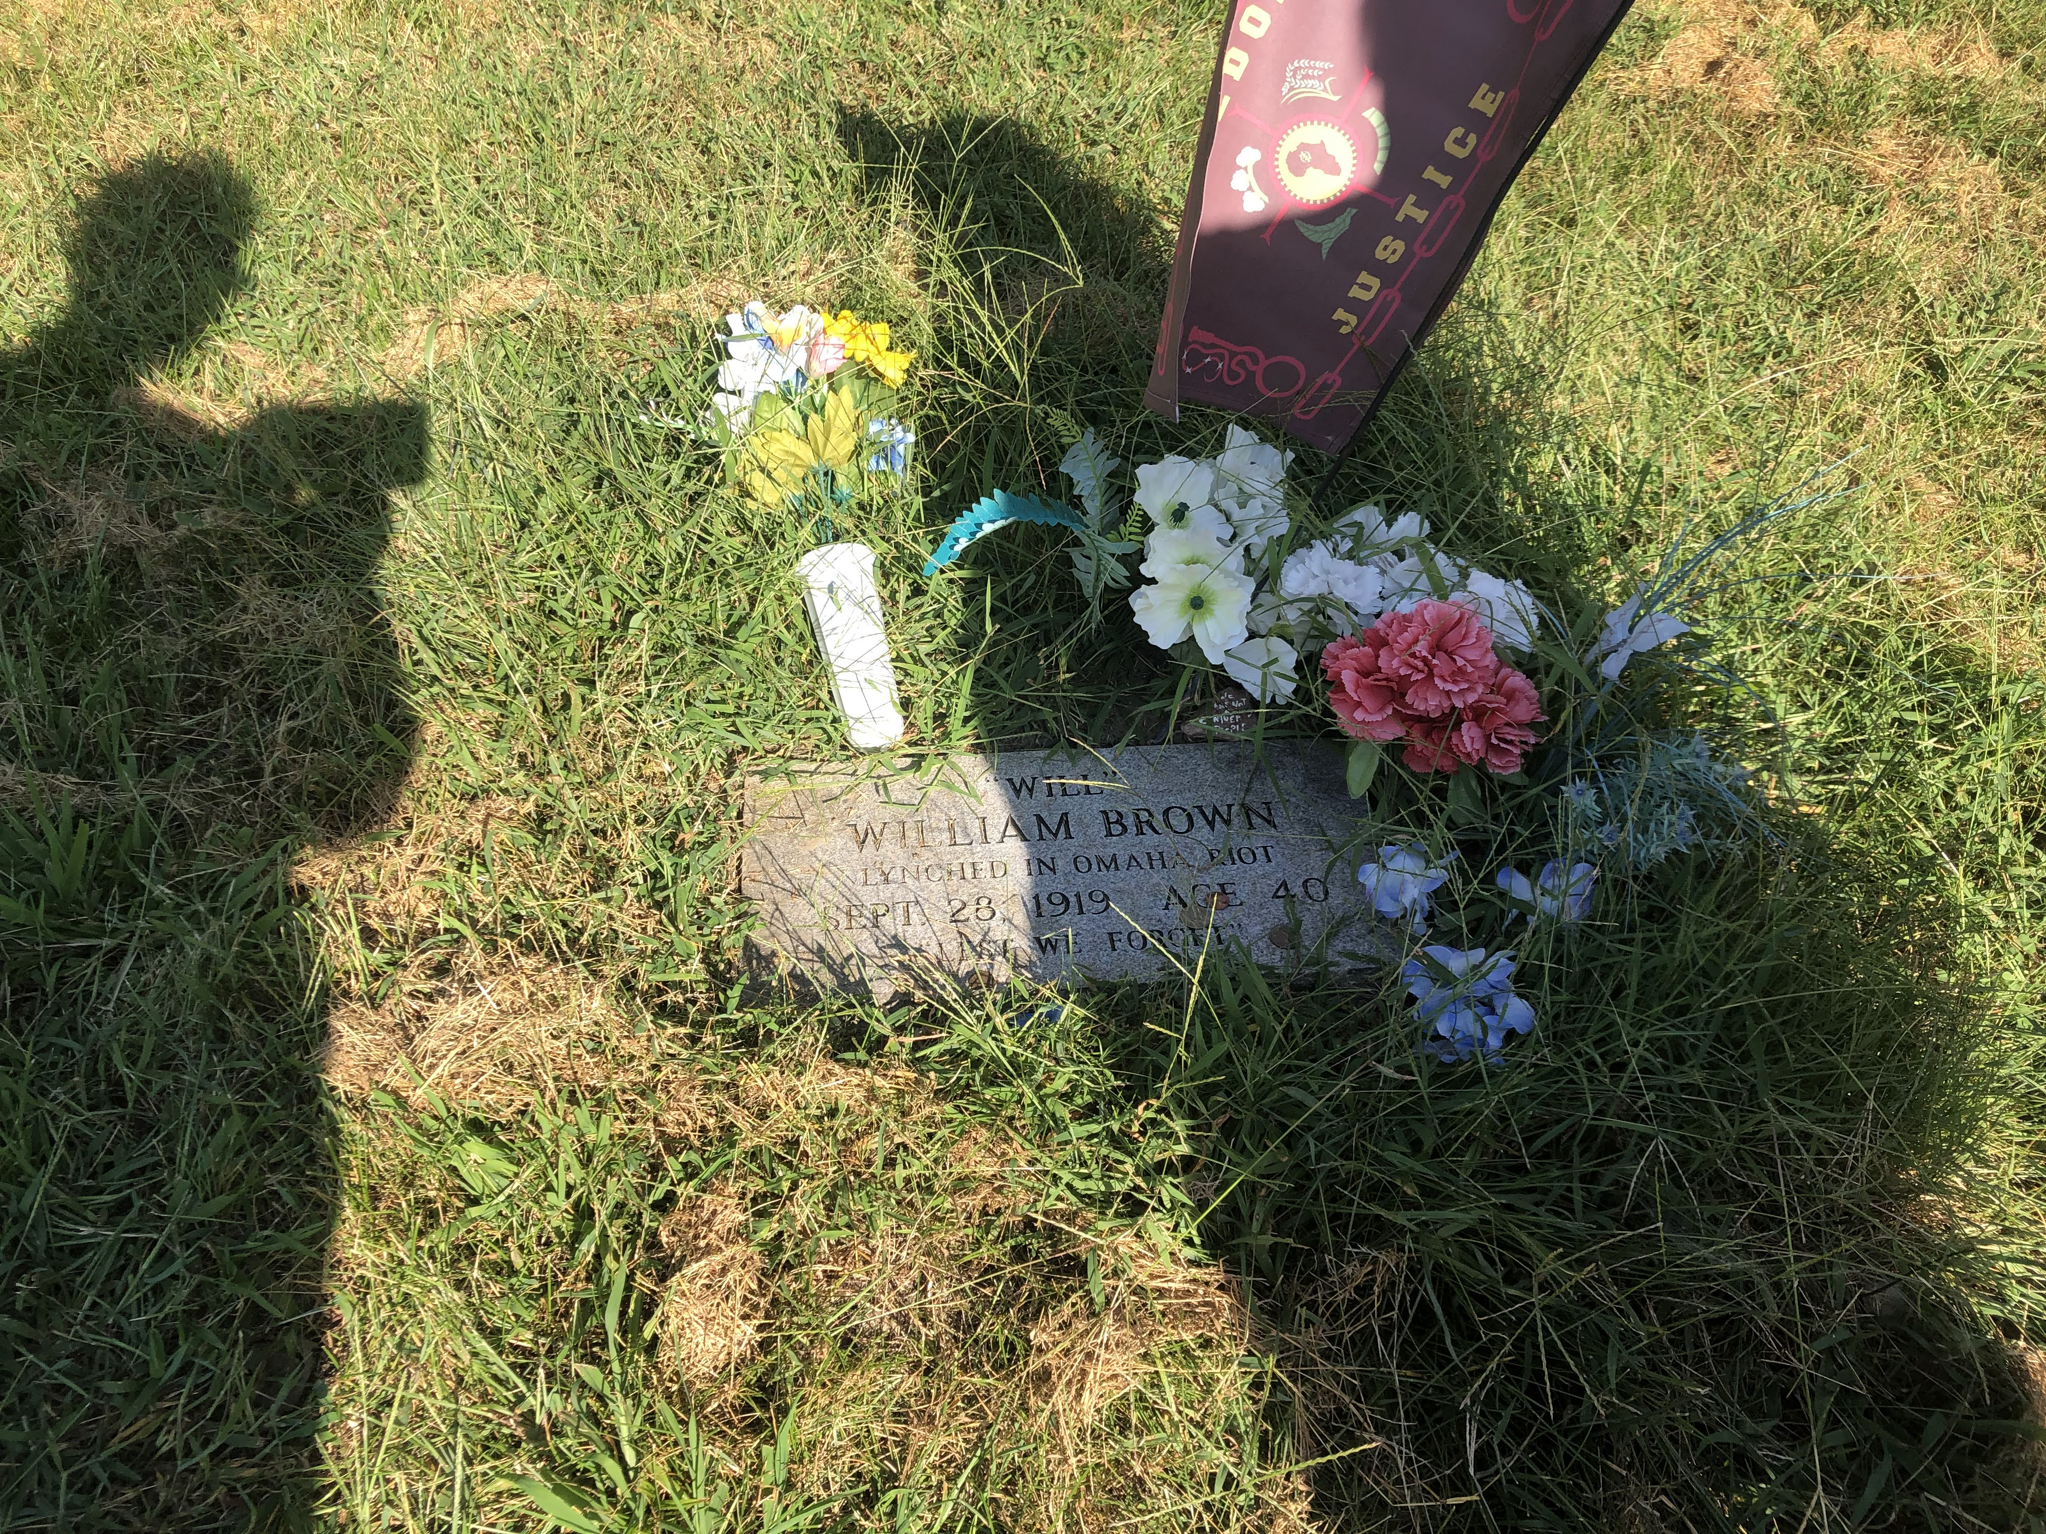
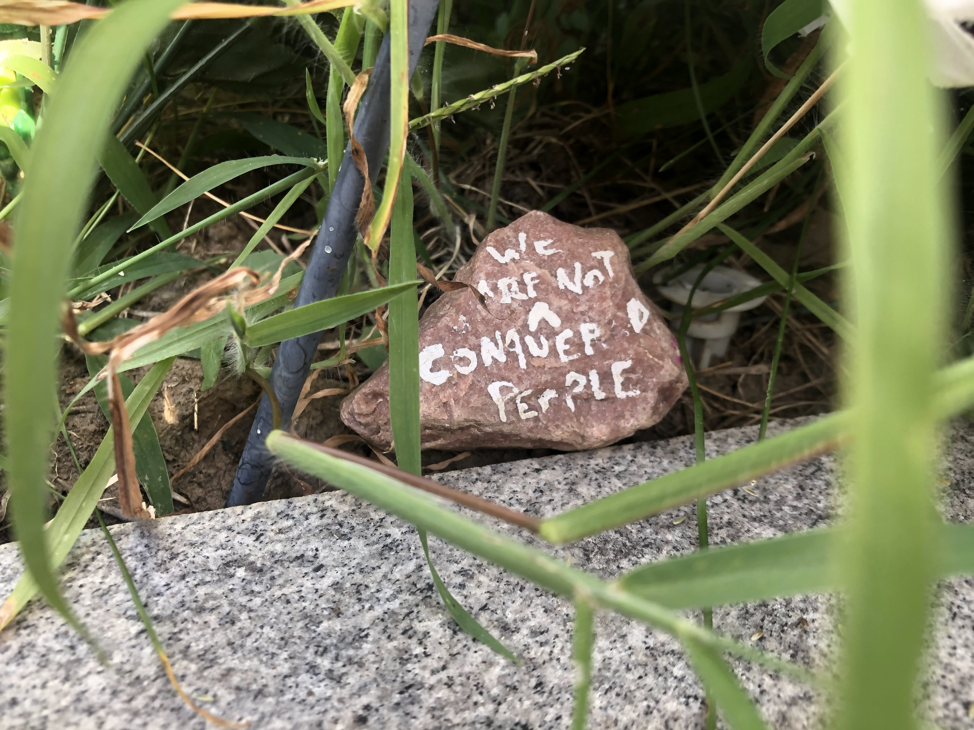
Memory

Slide 10
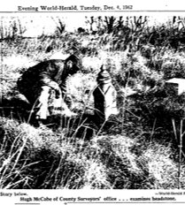
What did you find challenging in crafting your story about the site for a popular audience?
Lack of information
Forgotten on purpose

